Slide 1
Digi Yatra Presentation
Deepanshu Rohilla
Shubham Bajaj

Slide 2
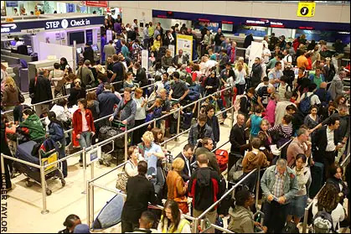
The need
Long queues at the airport.
Lesser time to explore the airport space.
Lower revenue for the airports.
Missed flights and last minute hassle.
Minimization of construction for new infrastructure.

Slide 3
Why is Digi Yatra required
Security
The entire solution should be made in such a way that the airport security is not compromised in any way. We don’t want another 9/11 or kandahar highjack.
Ease of usage
The basic purpose of the project is to make the entire onboarding process as seamless as possible. Thus, a first timer should not feel confused with the technology.
Cost of the process
With aviation industry already struggling with finances, this process should not add up to the existing costs for the airports.
Scientific approach
It is very important to take every step with proper research and looking at long term impact of the actions.
Collective working
Government, private companies, security units, and airport authorities have to work together for the seamless implementation of the project.

Slide 4
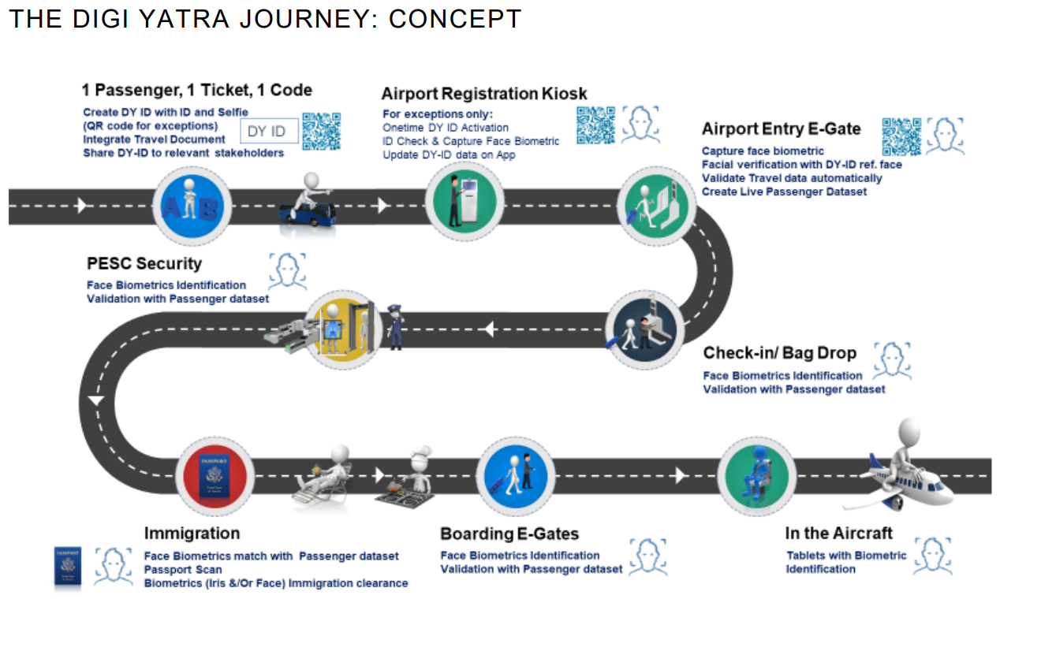

Slide 5
Processes.
DigiYatra will have a centralised registration system for passengers. Passenger can create Digi Yatra ID in a central system by providing details such as Name, Email ID, Mobile Number and Details of Identity (Voter Id, Driving License, Aadhar etc).
At the entry point E-Gate the pax will scan his boarding pass or e-ticket (Print or a soft copy in mobile).
On scanning the barcode/ QR code the system will validate the passenger details and flight details.
Digi Yatra ID will verify the identity by Face Recognition.
On successful verification of Ticket and Digi Yatra ID, e-Gate will open. Also, Face with ticket PNR is made in to a single token for the rest of the journey at the airport.
Passenger will gain entry to security area and aircraft Boarding through e-Gate operated on Facial Recognition System

Slide 6
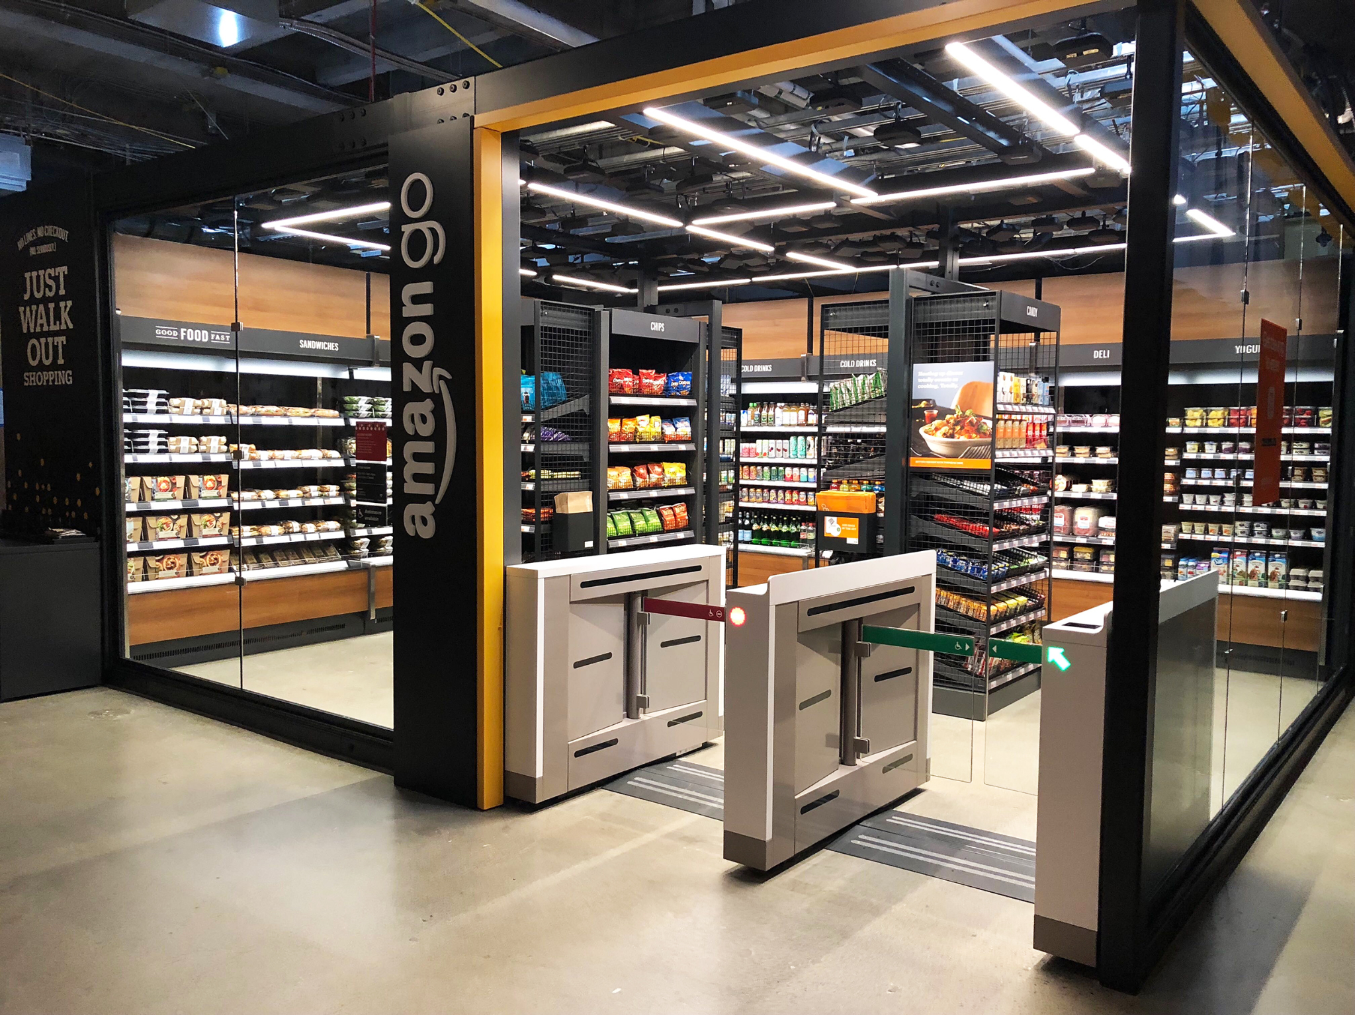
Is it even possible?.
Amazon Go is possible because of the same kinds of technologies used in self-driving cars: computer vision, sensor fusion, and deep learning.
a bunch of cameras and other sensors follow your progress through the store
Amazon’s patented “Just Walk Out” technology automatically detects when you lift products from shelves or put them back, and tracks them in a “virtual” shopping cart. When you’re done shopping, you just go.
You’ll receive a receipt on your app and your purchases will be billed to your Amazon account.

Slide 7
Understanding the beneficiaries.
The new process shall cater to all Passengers at any airport in India, be it Indian citizens (With or without Digi Yatra ID) or foreign nationals
The process shall simplify & ease the Passenger process equally for different Passenger types :
First time and frequent flyers in India
Group travelers and families
Foreign citizens or tourists

Slide 8
Privacy and security issues.
The DY credentials will be encrypted and stored in a secure Walter on the
passenger’s smart phone.
The data will not be centrally stored to minimise risk of theft or loss.
“DY credentials are shared only when travel happens and shared with passengers’ consent (by him/her) with airlines, airports and regulatory agencies if needed,” the DGCA order says.
Such data will be shared 24 hours beforeflight departure time and retained for 24 hours after that it will be purged from the system.
Privacy protection is built in through GDPR compliance

Slide 9
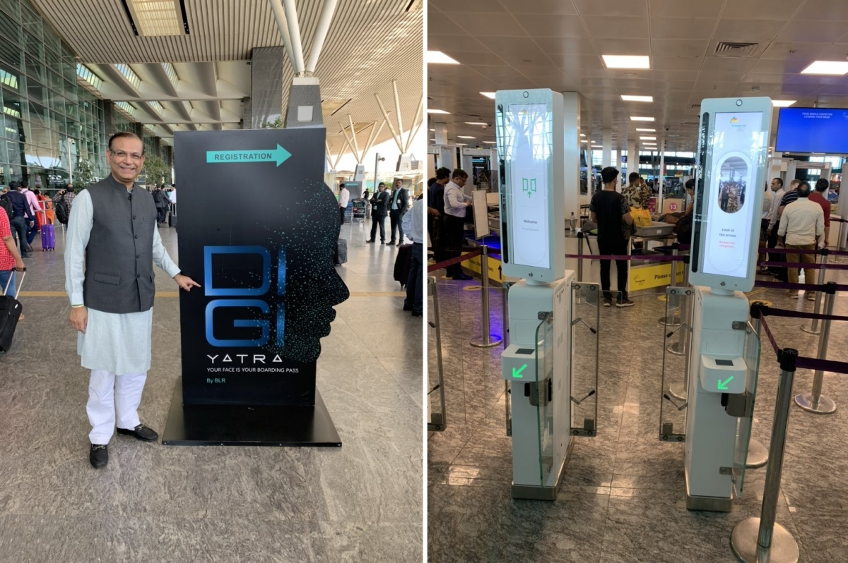
Actions already taken
Digi Yatra Central Ecosystem (DYCE) Challenge
Public private partnerships
Pilot projects at various airports (already done at BLR airport)

Slide 10
False positives
Major area of concern.
Invariants should be pessimistic
When in doubt, reject!!!

Slide 11
False negatives
Can be handled by authorities manually.
As long as this number is low enough, there is no issue.
Will keep reducing over time.

Slide 12
Flaws
No facial recognition system is 100% fool proof.
On a large scale this can be very detrimental for example IGIA has an average traffic of around 3,40,00,000 people per year. If we use an algorithm with 0.1% FAR (False Acceptance Rate), this still amounts to 34,000 which is a large amount of false rejections.
Server and maintenance cost is very high.
Alterations to a person’s appearance (due to applying makeup, wearing different glasses, etc.) in between checkpoints may result in further false rejections.

Slide 13
Resources
https://www.theguardian.com/world/2017/aug/01/passengers-facing-four-hour-security-queues-at-some-european-airports
https://www.google.com/url?sa=i&url=https%3A%2F%2Fwww.cnn.com%2F2018%2F12%2F12%2Ftech%2Famazon-go-small-format%2Findex.html&psig=AOvVaw3Hiy4HKA6quV8bcOJ8GMMN&ust=1654160669968000&source=images&cd=vfe&ved=0CAwQjRxqFwoTCJjb7O7yi_gCFQAAAAAdAAAAABAO
https://www.youtube.com/watch?v=4FMRQ2RUnFk
https://vikaspedia.in/e-governance/online-citizen-services/government-to-citizen-services-g2c/transport-related-services/digi-yatra-policy#:~:text=Processes%20at%20airport,-At%20the%20entry&text=On%20scanning%20the%20bar%20code,%2C%20e-Gate%20will%20open.
https://storyrepublik.com/article-amazon-go/

Slide 14
Thank you

